Slide 1

Online Encounter 15
Notes:
ENCOUNTER 15
REVIEW STUDENT PROGRESS
Check for last Encounter attendance.
Check for last Speaking Center attendance and time spent.
Check that Lesson 3 has been completed.
Prepare general comments on Student attendance, study habits, and overall progress.
VIDEO SUMMARY
Benny is excited about an upcoming football match. While he is waiting for the game to start, he fixes Shen’s computer. He and Shen talk about their parents. Shen then talks to his parents in China. They are worried that Shen does not have a job yet and also about whether Benny is a good roommate.
Khae and Aanya meet at the gym. They talk about their brothers and sisters and what they do. They hear strange noises and go to investigate; Benny is trying to bench press. He tries to lift too much weight and drops the bar on himself, so Aanya helps him lift the bar. Khae then tries the bench press successfully, much to Benny’s embarrassment.
Sofi reminisces about her grandmother’s cooking. Sofi, Paz, Shen, Benny, and John Berry talk together about their grandparents. Sofi makes chicken soup for everyone, but she adds too much mustard, and no one can eat it.
VOCABULARY OBJECTIVES
Can use basic language related to themselves and their family relations (children; kid)
Can name very basic family relations (brother; daughter; father; mother; sister; son; wife)
GRAMMAR OBJECTIVES
Can use a/an to talk about the names of jobs (He’s an architect.)
Can name very common job names based on common verbs (He is a teacher.)
Can ask and answer basic yes/no questions (Do you like the big city?)
Can talk about routines with very basic adverbs of frequency and prepositions of time (I work on Mondays.)
SPEAKING OBJECTIVES
Can give a short, structured description of home, family and job, with support (Her kitchen was warm.)
Can ask and answer basic questions about family and friends in a limited way (Is your grandmother alive?)

Slide 2

Encounter 15
Introductions
Your teacher
My name is .
Now please introduce yourself.
Notes:
INSTRUCTIONS
This is a warm-up activity and should not be assessed.
Introduce yourself to the Students. Then ask each individual Student what his/her name is. Tell the Students:
Hello. My name’s _______. What’s your name?
Sample Responses: My name’s _______./My name is _______.
TEACHING TIPS
Ask the Students about their study habits. (i.e. “Have you finished your Speaking Center Lessons? How about your Student Manual or Digital Book?”)
Check for IT issues.

Slide 3
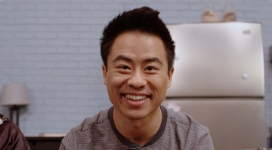
Part 1.0: Warm-Up
What can you say about this person?
.
He’s Shen. He lives with Benny
Notes:
1.1 Storyline Characters (5 min)
Allow one minute for this slide.
OBJECTIVE
To help the Students relax and start thinking in English
INSTRUCTIONS
This is a warm-up activity and should not be assessed.
#1. Have a Student read the question. [What can you say about this person?]
#2. Encourage a Student to answer with any information they know.
#3. Reveal the sample answer. [He’s Shen. He lives with Benny.]

Slide 4


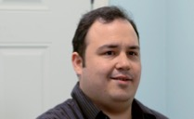

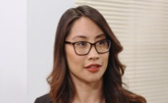
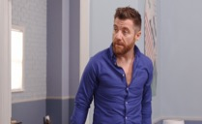
Part 1.0: Warm-Up
Talk about the people you see. Say at least five sentences.
Notes:
1.1 Storyline Characters
Allow four minutes for this slide.
INSTRUCTIONS
Have the Students take turns saying what they know about the characters from the video. Encourage the Students to say at lease five sentences each.
TEACHING TIP
If you have a stronger group, encourage the Students to give reasons or examples to explain their ideas. For example,
Benny is funny. He wears strange clothes.
Khae is very fit. She goes to the gym every day.

Slide 5
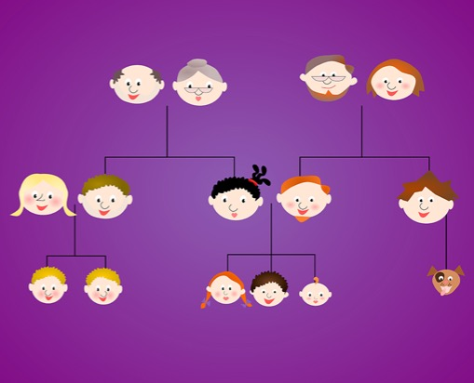

Part 2.0: Target Language
Activity 2.1: Context Creation
.
He’s my father
You
You
Who’s that?
Notes:
2.1 Family Quiz (10 min)
Allow one minute for this slide.
OBJECTIVES
Can use basic language related to themselves and their family relations (children; kid)
Can name very basic family relations (brother; daughter; father; mother; sister; son; wife)
INSTRUCTIONS
#1. Draw the Students’ attention to the image of the family tree, the character labeled “You,” and the arrow highlighting a family member (father). Have a Student read the question about the highlighted family member. [Who’s that?]
#2. Encourage the Students to answer.
#3. Reveal the answer. [He’s my father.]
TEACHING TIPS
Elicit a variety of the target vocabulary.
Elicit from each Student.
It helps to board elicited language.

Slide 6

Part 2.0: Target Language
Activity 2.1: Concept Check
.
He’s my brother
You
You
Who’s that?
Notes:
2.1 Family Quiz
Allow one minute for this slide.
INSTRUCTIONS
#1. Draw the Students’ attention to the image of the family tree, the character labeled “You,” and the arrow highlighting a family member (brother).
Have a Student read the question about the highlighted family member. [Who’s that?]
#2. Encourage the Students to answer.
#3. Reveal the sample answer. [He’s my brother.]
TEACHING TIP
Elicit target language from each Student.

Slide 7



Part 2.0: Target Language
Activity 2.1: Practice
➕
A
B
➕
➕
C
D
E
F
D
H
I
Notes:
2.1 Family Quiz
Allow four minutes for this slide.
INSTRUCTIONS
Gesture to A and Say, “Who is he?” and have the Students identify the corresponding member of the family tree. Do the same with the other family members. For example,
B. Who is she?–The grandmother
D. Who is she?–The daughter and mother
Elicit:
grandfather, grandmother, brother, sister, son, daughter, dad, mom, parents

Slide 8
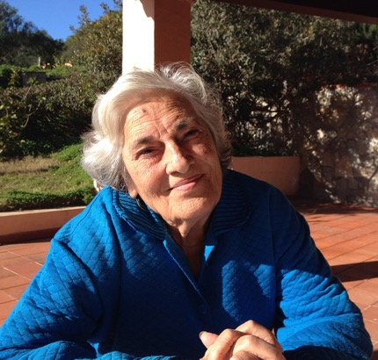
Part 2.0: Target Language
Activity 2.1: Practice
brother
daughter
Your parents’ son is your .
Your son’s sister is your .
Your father’s mother is your .
Another word for “father” is .
Your mother and father are your .
Your sons and daughters are your .
Your father’s daughter is your .
Your daughter’s brother is your .
grandmother
dad
parents
children
sister
son
Notes:
2.1 Family Quiz
Allow four minutes for this slide.
INSTRUCTIONS
Have the Students take turns reading the text and filling in the blanks to complete the sentences.
Reveal the answers:
#1. Your parents’ son is your brother.
#2. Your son’s sister is your daughter.
#3. Your father’s mother is your grandmother.
#4. Another word for “father” is dad.
#5. Your mother and father are your parents.
#6. Your sons and daughters are your children.
#7. Your father’s daughter is your sister.
#8. Your daughter’s brother is your son.
TEACHING TIP
Encourage the Students to work together, and to correct each other when appropriate.

Slide 9

Part 2.0: Target Language
Activity 2.1: Extension
Ask me three questions about my family.
Notes:
2.1 Family Quiz
Optional Extension
INSTRUCTIONS
Say the statement on the screen to the Students. [Ask me three questions about my family.]
Encourage the Students to ask YOU questions about your family. For example,
Do you have any brothers and sisters?
Do you have a big family?
Where do your parents live?
Answer the questions briefly.

Slide 10
Part 2.0: Target Language
Activity 2.1: Feedback
Student 1
Student 2
Student 3
Student 4
Great job!
Great job!
Great job!
Great job!
Well done
Well done
Well done
Well done
Good try
Good try
Good try
Good try
More practice
More practice
More practice
More practice
Feedback
Notes:
2.1 Family Quiz
FEEDBACK
Quickly give the Students feedback on the target language they just practiced.
Remind them of other resources they can take advantage of to improve their English:
Go to Wall Street World to practice grammar and vocabulary.
Review the Student Manual or Digital Book to study grammar and vocabulary.
Attend Complementary Classes to practice using grammar and vocabulary.
Join Social Clubs to practice speaking skills.

Slide 11

Part 3.0: Target Structures
Activity 3.1: Context Creation
.
They help sick people
My sister is a doctor. What do doctors do?
Tell me more jobs that you know.
Notes:
3.1 What Does She Do? (10 min)
Allow one minute for this slide.
OBJECTIVES
Can use a/an to talk about the names of jobs (He’s an architect.)
Can name very common job names based on common verbs (He is a teacher.)
INSTRUCTIONS
#1. Read the statement and question. [My sister is a doctor. What do doctors do?]
#2. Elicit possible answers.
#3. Reveal an example answer. [They help sick people.]
#4. Read the statement. [Tell me more jobs that you know.]
Encourage the Students to name jobs that they know.
TEACHING TIPS
Elicit examples of the target structure(s).
Elicit from each Student.
It helps to board elicited language.

Slide 12


Part 3.0: Target Structures
Activity 3.1: Context Creation
an
a
He’s actor.
She’s painter.
Notes:
3.1 What Does She Do?
Allow one minute for this slide.
INSTRUCTIONS
#1. Encourage the Students to read the text, filling in the missing words to complete the sentence.
#2. Reveal the answer and have the Students read the sentence. [He’s an actor.]
#3. Encourage the Students to read the text, filling in the missing words to complete the sentence.
#4. Reveal the answer and have the Students read the sentence. [She’s a painter.]
TEACHING TIPS
Elicit examples of the target structure(s).
Elicit from each Student.
It helps to board elicited language.

Slide 13
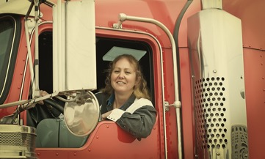
Part 3.0: Target Structures
Activity 3.1: Concept Check
paints
She .
.
A driver
Notes:
3.1 What Does She Do?
Allow one minute for this slide.
INSTRUCTIONS
Ask the Students, “Why do we say a painter, but we say an actor?” The Students should respond that “an” is used before the words that begin with a, e, i, o, u.
Then ask, “What does a painter do?”
#1. Encourage the Students to answer. [She ______.]
#2. Reveal the answer. [She paints.]
Say to the Students, “Someone who paints is a painter. How about someone who drives?”
#3. Encourage the Students to answer.
#4. Reveal the answer. [A driver.]
TEACHING TIP
Elicit target language from each Student.

Slide 14
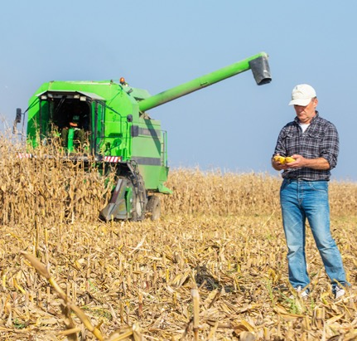
Part 3.0: Target Structures
Activity 3.1: Practice
.
He’s a farmer
.
He farms
job?
What’s his
What does he do?
Notes:
3.1 What Does She Do?
Allow one minute for this slide.
INSTRUCTIONS
#1. Have a Student fill in the missing words to complete the question.
#2. Reveal the question. [What’s his job?]
#3. Encourage the Students to answer.
#4. Reveal the answer. [He’s a farmer.]
#5. Have a Student read the question. [What does he do?]
#6. Encourage the Students to answer.
#7. Reveal the answer. [He farms.]

Slide 15


Part 3.0: Target Structures
Activity 3.1: Practice
1
2
.
.
?
?
Notes:
3.1 What Does She Do?
Allow two minutes for this slide.
INSTRUCTIONS
Say to the Students, “For each picture, ask the question ‘What’s his/her job?’ and ‘What does …. do?’”
ANSWER KEY
A: What’s his job?
B: He’s a teacher.
A: What does he do?
B: He teaches.
A: What’s his job?
B: He’s an architect.
A: What does he do?
B: He designs buildings. [possible answer]
TEACHING TIPS
Make note of any jobs that the Students have difficulties with, and repeat the activity a second time using only those jobs.
If you have a weaker group, have them write the questions down before starting the activity. For example,
What’s his job?
What’s her job?
What does [a teacher] do?

Slide 16
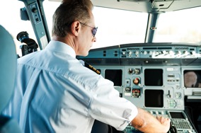

Part 3.0: Target Structures
Activity 3.1: Practice
3
4
?
?
.
.
Notes:
3.1 What Does She Do?
Allow two minutes for this slide.
INSTRUCTIONS
Have the Students ask and answer the target questions.
ANSWER KEY
A: What’s his job?
B: He’s a pilot.
A: What does he do?
B: He flies planes.
A: What’s his job?
B: He’s a Student.
A: What does he do?
B: He studies.

Slide 17

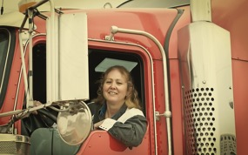
Part 3.0: Target Structures
Activity 3.1: Practice
5
6
.
.
?
?
Notes:
3.1 What Does She Do?
Allow one minute for this slide.
INSTRUCTIONS
Have the Students ask and answer the target questions.
ANSWER KEY
A: What’s his job?
B: He’s a chef/cook.
A: What does he do?
B: He cooks.
A: What’s her job?
B: She’s a driver.
A: What does she do?
B: She drives.

Slide 18


Part 3.0: Target Structures
Activity 3.1: Practice
7
8
.
.
?
?
Notes:
3.1 What Does She Do?
Allow one minute for this slide.
INSTRUCTIONS
Have the Students ask and answer the target questions.
ANSWER KEY
A: What’s her job?
B: She’s a dancer.
A: What does she do?
B: She dances.
A: What’s his job?
B: He’s a waiter.
A: What does he do?
B: He serves people in a restaurant.

Slide 19
Part 3.0: Target Structures
Activity 3.1: Feedback
Student 1
Student 2
Student 3
Student 4
Great job!
Great job!
Great job!
Great job!
Well done
Well done
Well done
Well done
Good try
Good try
Good try
Good try
More practice
More practice
More practice
More practice
Feedback
Notes:
3.1 What Does She Do?
FEEDBACK
Quickly give the Students feedback on the target language they just practiced.
Remind them of other resources they can take advantage of to improve their English:
Go to Wall Street World to practice grammar and vocabulary.
Review the Student Manual or Digital Book to study grammar and vocabulary.
Attend Complementary Classes to practice using grammar and vocabulary.
Join Social Clubs to practice speaking skills.

Slide 20

Part 3.0: Target Structures
Activity 3.2: Context Creation
.
He studies
He’s a Student. What does he do?
Notes:
3.2 Do You Do It Every Day? (10 min)
Allow one minute for this slide.
OBJECTIVES
Can ask and answer basic yes/no questions (Do you like the big city?)
Can talk about routines with very basic adverbs of frequency and prepositions of time (I work on Mondays.)
INSTRUCTIONS
#1. Have a Student read the statement and question. [He’s a Student. What does he do?]
#2. Encourage a Student to answer.
#3. Reveal the answer. [He studies.]
TEACHING TIPS
Elicit examples of the target structure(s).
Elicit from each Student.
It helps to board elicited language.

Slide 21

Part 3.0: Target Structures
Activity 3.2: Context Creation
He studies .
Monday study
Tuesday study
Wednesday study
Thursday study
Friday study
Saturday study
Sunday study
every day
He studies from Monday
to Sunday.
Notes:
3.2 Do You Do It Every Day?
Allow one minute for this slide.
INSTRUCTIONS
Draw the Students’ attention to the schedule.
#1. Have a Student read the statement. [He studies from Monday to Sunday.]
#2. Have a Student read the text, filling in the missing words to complete the sentence.
#3. Reveal the answer. [He studies every day.]
TEACHING TIPS
Elicit examples of the target structure(s).
Elicit from each Student.
It helps to board elicited language.

Slide 22
Part 3.0: Target Structures
Activity 3.2: Concept Check
He studies.
study?
Monday study
Tuesday
Wednesday study
Thursday
Friday study
Saturday
Sunday study
sometimes
Does he sometimes
.
.
Yes, he does
Do you sometimes study?
Notes:
3.2 Do You Do It Every Day?
Allow two minutes for this slide.
INSTRUCTIONS
Draw the Students’ attention to the different schedule.
#1. Have a Student read the text, filling in the missing word to complete the sentence.
#2. Reveal the answer. [He sometimes studies.]
#3. Ask a Student to fill in the missing words to complete the question.
#4. Reveal the answer. [Does he sometimes study?]
#5. Ask a Student to answer.
#6. Reveal the answer. [Yes, he does.]
#7. Have a Student read the question. [Do you sometimes study?]
#8. Have another Student answer.
Then ask, “Why do we use words like sometimes, always and never?”
Elicit an answer. For example,
To say how often something happens.
TEACHING TIPS
Elicit target language from each Student.
If the Students have trouble differentiating between the different adverbs of frequency, draw the following scale on the board:
100% = Every day/every weekend
30-80% = Sometimes
0% = Never

Slide 23


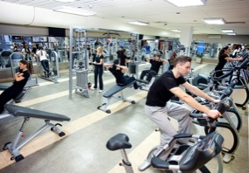
Part 3.0: Target Structures
Activity 3.2: Practice
Use the picture and time to ask and answer: Do you …. ?
sometimes always never often every day
Mondays and Wednesdays
Monday to Sunday
Saturdays and Sundays
Notes:
3.2 Do You Do It Every Day?
Allow two minutes for this slide.
INSTRUCTIONS
Have the Students take turns asking questions about the actions in the pictures and answering with a word from the box. For example,
A: Do you sometimes ride a bicycle on Mondays and Wednesdays?
B: Yes I do. I ride a bicycle every day.

Slide 24

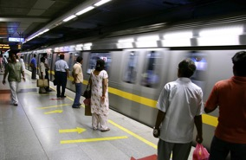

Part 3.0: Target Structures
Activity 3.2: Practice
Use the picture and time to ask and answer: Do you …. ?
sometimes always never often every day
Fridays
Monday to Sunday
Saturdays and Sundays
Notes:
3.2 Do You Do It Every Day?
Allow two minutes for this slide.
INSTRUCTIONS
Have the Students take turns asking questions about the actions in the pictures and answering with a word from the box. For example,
A: Do you sometimes go shopping on Fridays?
B: Yes I do. I always go shopping on Fridays.

Slide 25


Part 3.0: Target Structures
Activity 3.2: Practice
Use the picture and time to ask and answer: Do you …. ?
sometimes always never often every day
Monday to Sunday
Monday to Friday
Notes:
3.2 Do You Do It Every Day?
Allow two minutes for this slide.
INSTRUCTIONS
Have the Students take turns asking questions about the actions in the pictures and answering with a word from the box. For example,
A: Do you always cook from Monday to Sunday?
B: No, I don’t. I never cook.

Slide 26

Part 3.0: Target Structures
Activity 3.2: Extension
sometimes always never often every day
Notes:
3.2 Do You Do It Every Day?
Optional Extension
INSTRUCTIONS
Have the Students give other examples of things they do using these time expressions,
Every day
Every weekend
Sometimes
Never
TEACHING TIP
If you have a stronger group, have the Students make the questions and ask each other.

Slide 27
Part 3.0: Target Structures
Activity 3.2: Feedback
Student 1
Student 2
Student 3
Student 4
Great job!
Great job!
Great job!
Great job!
Well done
Well done
Well done
Well done
Good try
Good try
Good try
Good try
More practice
More practice
More practice
More practice
Feedback
Notes:
3.2 Do You Do It Every Day?
FEEDBACK
Quickly give the Students feedback on the target language they just practiced.
Remind them of other resources they can take advantage of to improve their English:
Go to Wall Street World to practice grammar and vocabulary.
Review the Student Manual or Digital Book to study grammar and vocabulary.
Attend Complementary Classes to practice using grammar and vocabulary.
Join Social Clubs to practice speaking skills.

Slide 28

Part 4.0: Communication
Activity 4.1: Context Creation
I have a brother. Can you ask me some questions about my brother?
Notes:
4.1 Talking about Your Family (10 min)
Allow two minutes for this slide.
OBJECTIVES
Can ask and answer basic yes/no questions (Do you like the big city?)
Can use basic language related to themselves and their family relations (children; kid)
Can ask and answer basic questions about family and friends in a limited way (Is your grandmother alive?)
Can give a short, structured description of home, family and job, with support (Her kitchen was warm.)
INSTRUCTIONS
Read the statement and question on the screen to the Students. [I have a brother. Can you ask me some questions about my brother?]
Encourage the Students to ask YOU questions about your brother. For example,
Is he married?
What’s his job?
What does he do at work?
Does he have children?
Answer the questions briefly.
TEACHING TIPS
Brainstorm/Elicit a variety of the target language, which will be used and assessed during the practice.
Elicit from each Student.
It helps to board elicited language.

Slide 29
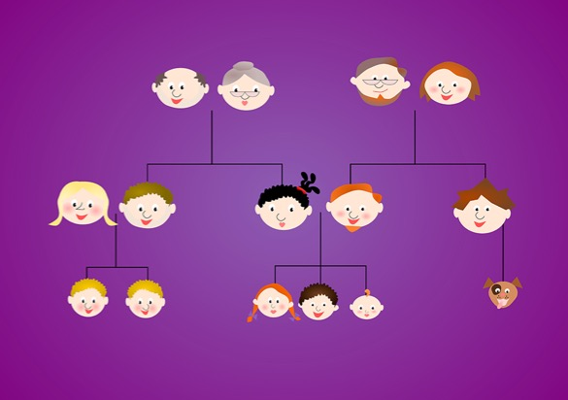
Part 4.0: Communication
Activity 4.1: Practice
You
Age:
Married:
Job:
Live:
What you do at work:
Your
Age:
Married:
Job:
Lives:
What s/he does at work:
Notes:
4.1 Talking about Your Family
Allow eight minutes for this slide.
INSTRUCTIONS
Tell the Students they are going to talk about themselves and their families.
Have the Students ask each other information about themselves. For example: A: How old are you?
B: I’m twenty years old.
A: Are you married?
B: No, I’m not.
Then tell the Students to choose one person in their family. Give the Students time to prepare.
Have each Student describe his/her family member, describing the age, marital status, job, etc.
Then have the Students ask other questions about their families, using the people on the screen. For example,
A: Do you have a sister?
B: Yes, I do.
A: Is she married?
B: Yes, she is.
At the end, have each Student say something s/he has learned about the family member of one of their classmate. For example,
Yin is 35 years old. She is a doctor. She helps sick people. She has two kids, and she lives in Shanghai.
TEACHING TIPS
The teacher can ask the Student which relative they want to talk about and write the relationship of that person on the screen for the other Students to ask about.
If the Students need more practice, have them choose a new relative to discuss and then repeat the activity.
If you have a stronger group, encourage the Students to add their own questions to those on the screen.

Slide 30
Part 4.0: Communication
Activity 4.1: Feedback
 |  | Great job! | Well done | Good try | Need more practice
Student 1 | Range: How well you produce a range of language
 | Accuracy: How often you make mistakes
 | Quality of interaction: How well you ask and answer questions
 | Fluency and Spoken Production: How clearly you present ideas
Student 2 | Range: How well you produce a range of language
 | Accuracy: How often you make mistakes
 | Quality of interaction: How well you ask and answer questions
 | Fluency and Spoken Production: How clearly you present ideas
Student 3 | Range: How well you produce a range of language
 | Accuracy: How often you make mistakes
 | Quality of interaction: How well you ask and answer questions
 | Fluency and Spoken Production: How clearly you present ideas
Student 4 | Range: How well you produce a range of language
 | Accuracy: How often you make mistakes
 | Quality of interaction: How well you ask and answer questions
 | Fluency and Spoken Production: How clearly you present ideas
Notes:
4.1 Talking about Your Family
FEEDBACK
Quickly give the Students feedback on the target language they just practiced.
Remind them of other resources they can take advantage of to improve their English:
Go to Wall Street World to practice grammar and vocabulary.
Review the Student Manual or Digital Book to study grammar and vocabulary.
Attend Complementary Classes to practice using grammar and vocabulary.
Join Social Clubs to practice speaking skills.

Slide 31

Part 4.0: Communication
Activity 4.2: Context Creation
.
I have a brother. He’s a pilot. What do you think he does every day?
He usually travels to other countries
He flies planes every day.
He goes to the airport every day.
What does he usually do?
Notes:
4.2 My Brother’s a Pilot (10 min)
Allow two minutes for this slide.
OBJECTIVES
Can talk about routines with very basic adverbs of frequency and prepositions of time (I work on Mondays.)
Can use a/an to talk about the names of jobs (He’s an architect.)
Can name very common job names based on common verbs (He is a teacher.)
Can name very basic family relations (brother; daughter; father; mother; sister; son; wife)
INSTRUCTIONS
Read the statements and question on the screen to the Students. [I have a brother. He’s a pilot. What do you think he does every day?]
Elicit answers about your brother. For example,
#1. Reveal the sample answers. [He flies planes every day./He goes to the airport every day.]
#2. Ask the second question on the screen. [What does he usually do?]
#3. Encourage the Students to answer.
#4. Reveal the sample answer. [He usually travels to other countries.]
TEACHING TIPS
Brainstorm/Elicit a variety of the target language, which will be used and assessed during the practice.
Elicit from each Student.
It helps to board elicited language.

Slide 32



Part 4.0: Communication
Activity 4.2: Practice
Talk about one person. You need to say:
Does s/he have a job? If yes, what is it?
What s/he does every day
What s/he does at the weekends
What s/he often does
What s/he never does
Aran Demir
Lawan Demir
Sanit Demir
Notes:
4.2 My Brother’s a Pilot
Allow four minutes for this slide.
INSTRUCTIONS
Have each Student choose a different person to talk about and give them time to prepare answers to the prompts. Then tell the Students to talk about the family member they have chosen, their jobs, and their habits.
The Students should follow the prompts, making one sentence for each. For example,
Aran Demir is a doctor.
He works in the hospital every day.
He sometimes works at the weekends.
He often feels tired.
He never goes to bed after 10.00 pm.

Slide 33



Part 4.0: Communication
Activity 4.2: Practice
Talk about one person. You need to say:
Does s/he have a job? If yes, what is it?
What s/he does every day
What s/he does at the weekends
What s/he often does
What s/he never does
Michelle Martin
Daniel Martin
Kayla Martin
Notes:
4.2 My Brother’s a Pilot
Allow four minutes for this slide.
INSTRUCTIONS
Have each Student choose a different person to talk about and give them time to prepare answers to the prompts. Then tell the Students to talk about the family member they have chosen, their jobs, and their habits.
The Students should follow the prompts, making one sentence for each.

Slide 34
Part 4.0: Communication
Activity 4.2: Feedback
 |  | Great job! | Well done | Good try | Need more practice
Student 1 | Range: How well you produce a range of language
 | Accuracy: How often you make mistakes
 | Quality of interaction: How well you ask and answer questions
 | Fluency and Spoken Production: How clearly you present ideas
Student 2 | Range: How well you produce a range of language
 | Accuracy: How often you make mistakes
 | Quality of interaction: How well you ask and answer questions
 | Fluency and Spoken Production: How clearly you present ideas
Student 3 | Range: How well you produce a range of language
 | Accuracy: How often you make mistakes
 | Quality of interaction: How well you ask and answer questions
 | Fluency and Spoken Production: How clearly you present ideas
Student 4 | Range: How well you produce a range of language
 | Accuracy: How often you make mistakes
 | Quality of interaction: How well you ask and answer questions
 | Fluency and Spoken Production: How clearly you present ideas
Notes:
4.2 My Brother’s a Pilot
FEEDBACK
Quickly give the Students feedback on the target language they just practiced.
If you have a full class, focus on just a couple points each (i.e. their greatest strength and what they need to work on).
Remind them of other resources they can take advantage of to improve their English:
Go to Wall Street World to practice grammar and vocabulary.
Review the Student Manual or Digital Book to study grammar and vocabulary.
Attend Complementary Classes to practice using grammar and vocabulary.
Join Social Clubs to practice speaking skills.

Slide 35
Encounter 15
Overall Feedback
 |  | Great job! | Well done | Good try | Need more practice
 | Activity 2.1: Family Quiz
 | Activity 3.1: What Does She Do?
 | Activity 3.2: Do You Do It Every Day?
 | Activity 4.1: Talking about Your Family
 | Activity 4.2: My Brother’s a Pilot
Student 1
Feedback
Notes:
OVERALL FEEDBACK (3–5 min)
Allow one minute for this slide.
Explain to the Students that you will now be giving them an overall assessment and recommendations. Use the following prompts to help you explain the assessment:
First, you did a really good job of…
The areas where you could use a little more practice are…
The language points I didn’t hear you use were...
As a result, I’d recommend that you… [continue on to Unit 16… work on (X, Y, Z ) and repeat Encounter 15].
Do you have any questions?

Slide 36
Encounter 15
Overall Feedback
 |  | Great job! | Well done | Good try | Need more practice
 | Activity 2.1: Family Quiz
 | Activity 3.1: What Does She Do?
 | Activity 3.2: Do You Do It Every Day?
 | Activity 4.1: Talking about Your Family
 | Activity 4.2: My Brother’s a Pilot
Student 2
Feedback
Notes:
OVERALL FEEDBACK (3–5 min)
Allow one minute for this slide.
Explain to the Students that you will now be giving them an overall assessment and recommendations. Use the following prompts to help you explain the assessment:
First, you did a really good job of…
The areas where you could use a little more practice are…
The language points I didn’t hear you use were...
As a result, I’d recommend that you… [continue on to Unit 16… work on (X, Y, Z ) and repeat Encounter 15].
Do you have any questions?

Slide 37
Encounter 15
Overall Feedback
 |  | Great job! | Well done | Good try | Need more practice
 | Activity 2.1: Family Quiz
 | Activity 3.1: What Does She Do?
 | Activity 3.2: Do You Do It Every Day?
 | Activity 4.1: Talking about Your Family
 | Activity 4.2: My Brother’s a Pilot
Student 3
Feedback
Notes:
OVERALL FEEDBACK (3–5 min)
Allow one minute for this slide.
Explain to the Students that you will now be giving them an overall assessment and recommendations. Use the following prompts to help you explain the assessment:
First, you did a really good job of…
The areas where you could use a little more practice are…
The language points I didn’t hear you use were...
As a result, I’d recommend that you… [continue on to Unit 16… work on (X, Y, Z ) and repeat Encounter 15].
Do you have any questions?

Slide 38
Encounter 15
Overall Feedback
 |  | Great job! | Well done | Good try | Need more practice
 | Activity 2.1: Family Quiz
 | Activity 3.1: What Does She Do?
 | Activity 3.2: Do You Do It Every Day?
 | Activity 4.1: Talking about Your Family
 | Activity 4.2: My Brother’s a Pilot
Student 4
Feedback
Notes:
OVERALL FEEDBACK (3–5 min)
Allow one minute for this slide.
Explain to the Students that you will now be giving them an overall assessment and recommendations. Use the following prompts to help you explain the assessment:
First, you did a really good job of…
The areas where you could use a little more practice are…
The language points I didn’t hear you use were...
As a result, I’d recommend that you… [continue on to Unit 16… work on (X, Y, Z ) and repeat Encounter 15].
Do you have any questions?

Slide 39


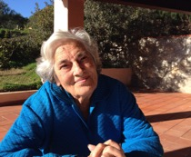

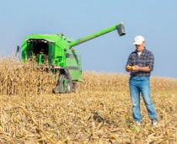
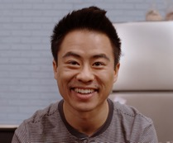


Part 5.0: Wrap-Up
A
B
C
D
E
F
G
H
Notes:
5.1 Who Is It? (5 min)
Allow five minutes for this slide.
OBJECTIVE
• To review and practice target language from the Unit
INSTRUCTIONS
Have the Students take turns describing one of the people they see. The other Students compete to see who can be first to name the corresponding person. For example,
A: This is a man.
B: Is it the architect?
A: No, it isn’t.
A: This person helps sick people.
B: Is it the doctor?
A: Yes, it is.

Slide 40

Thank you for coming.
We hope you enjoyed the class.
Don’t forget
to leave feedback!
Teacher
Class was fun
Instructions were clear
«««««
«««««
«««««
«««««
«««««
«««««

Slide 41
© 2017 by Pearson Education Limited All rights reserved.
No part of this publication may be reproduced, stored in a retrieval system, or transmitted in any form or by any means, electronic, mechanical, photocopying, recording or otherwise without the permission of the Publishers.
This material is the intellectual property of Pearson Education Limited.
Image Credits:
Lel Soleil/Fotolia; Phattman/Fotolia; oticki/Fotolia; tiero/Fotolia; aerogondo/Fotolia; alphaspirit/Fotolia; grimaldello/Fotolia; gstockstudio/Fotolia; ramonespelt/Fotolia; oneinchpunch/ Fotolia; Igor Mojzes/Fotolia; SkyLine/Fotolia; paul prescott/Fotolia; viperagp/Fotolia; jillchen/ Fotolia; ambrozinio/Fotolia; Monkey Business/Fotolia; Monkey Business/Fotolia; michaeljung/Fotolia; DragonImages/Fotolia; burachet/Fotolia; ake1150/Fotolia; michaeljung/Fotolia; michaeljung/Fotolia; WavebreakMediaMicro/Fotolia; letuve/Fotolia; sepy/Fotolia

